Slide 1
Data Wrangling in R
Reproducible Research

Slide 2
What is Reproducible Research?
Author
Published Article
Nature
Protocol
Express train to nature
Scientific Question
Reader

Slide 3
What is Reproducible Research?
Author
Presentation code
Processing code
Analytic code
Figures
Measured Data
Analytic Data
Computational Results
Tables
Published Article
Nature
Numerical Summaries
Text
Protocol
Scientific Question
Reader
Notes:
Authors and Readers want to go in opposite directions
Why don’t we meet in the middle?

Slide 4
Uh….who cares?

Slide 5


Slide 6
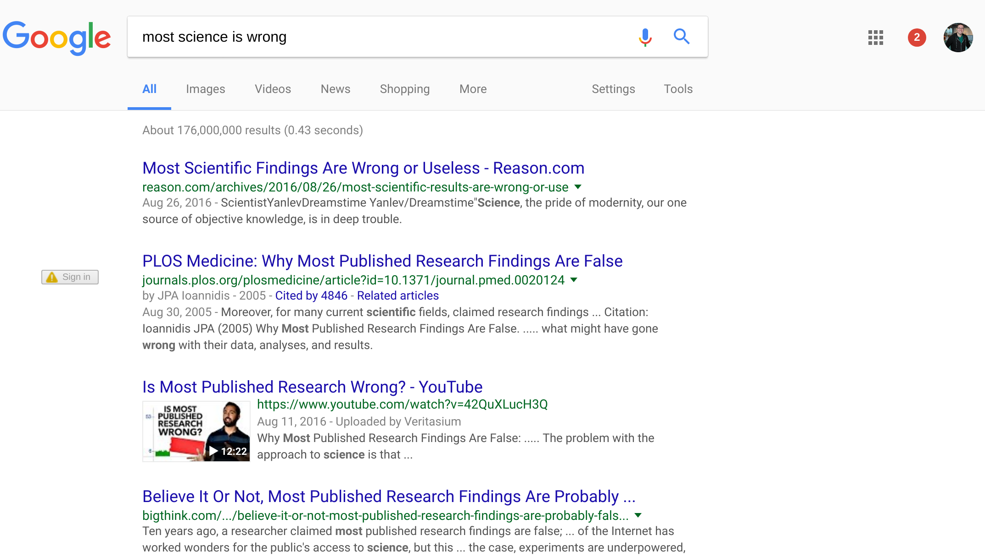
176,000,000!

Slide 7
Reproduce & replicate

Slide 8
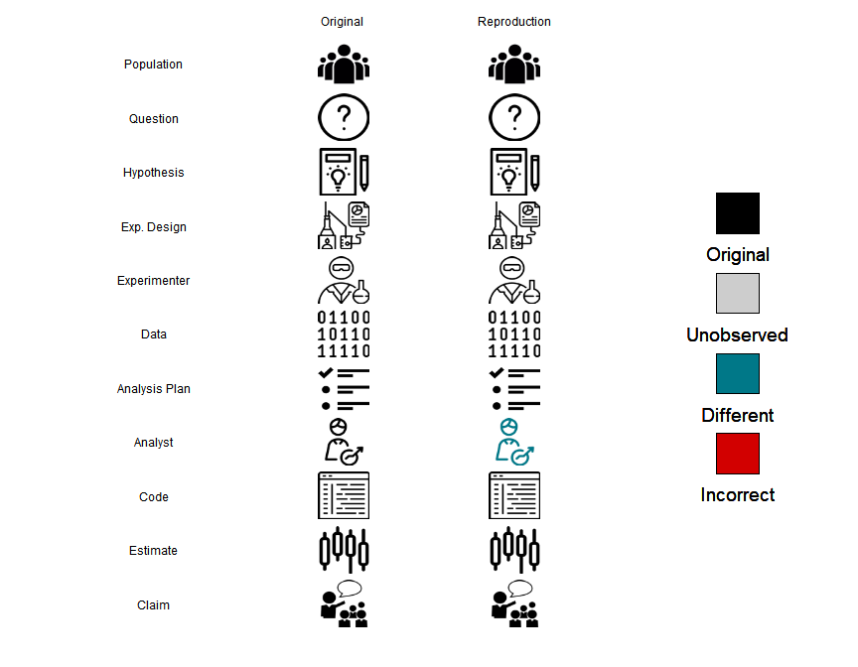
https://cran.r-project.org/web/packages/scifigure/vignettes/Visualizing_Scientific_Replication.html

Slide 9
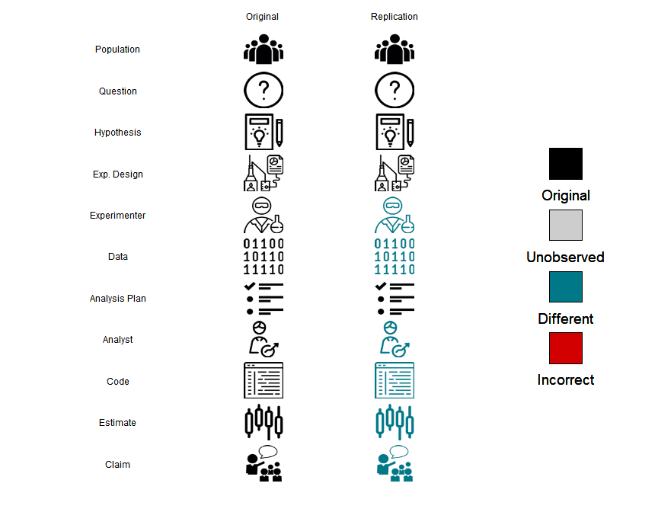
https://cran.r-project.org/web/packages/scifigure/vignettes/Visualizing_Scientific_Replication.html

Slide 10
When human harm isn’t involved

Slide 11
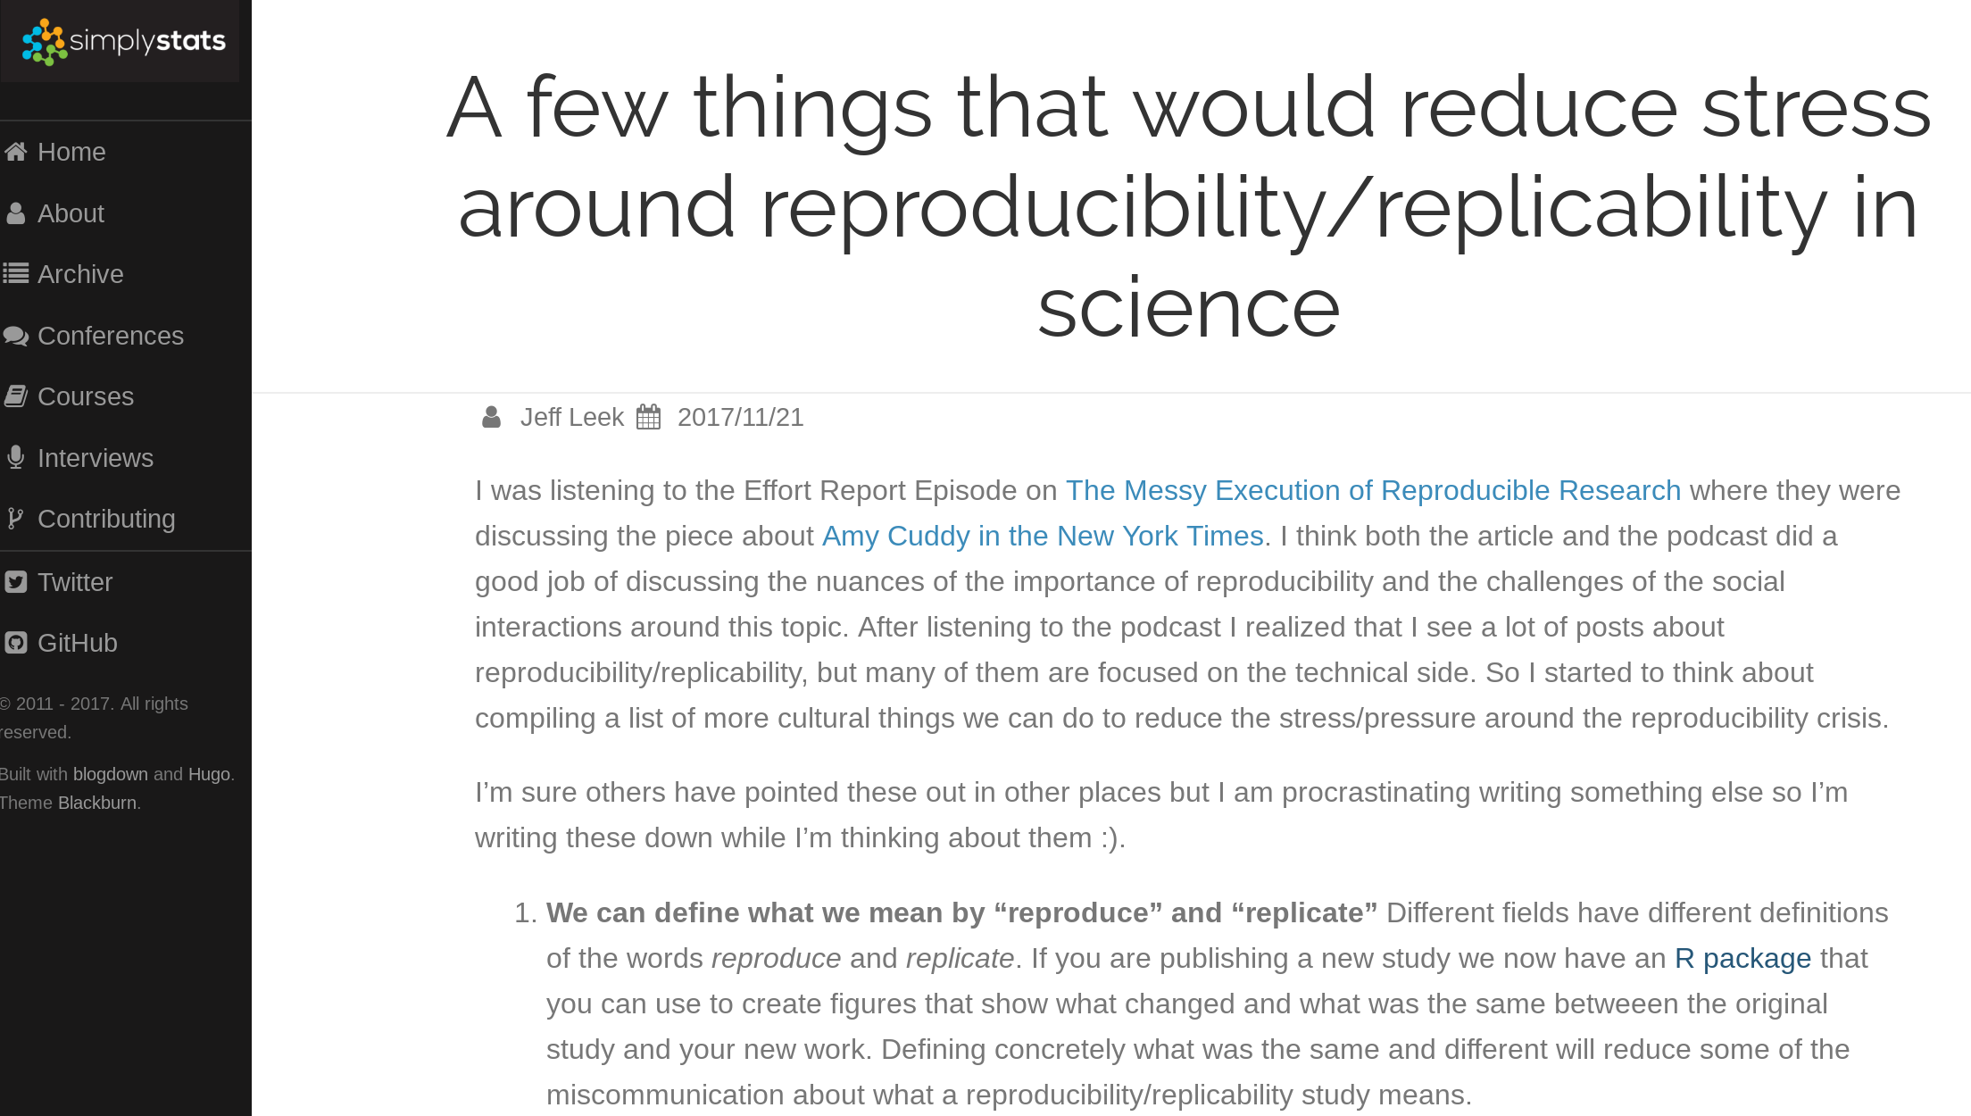
https://simplystatistics.org/2017/11/21/rr-sress/

Slide 12
When human harm could happen

Slide 13
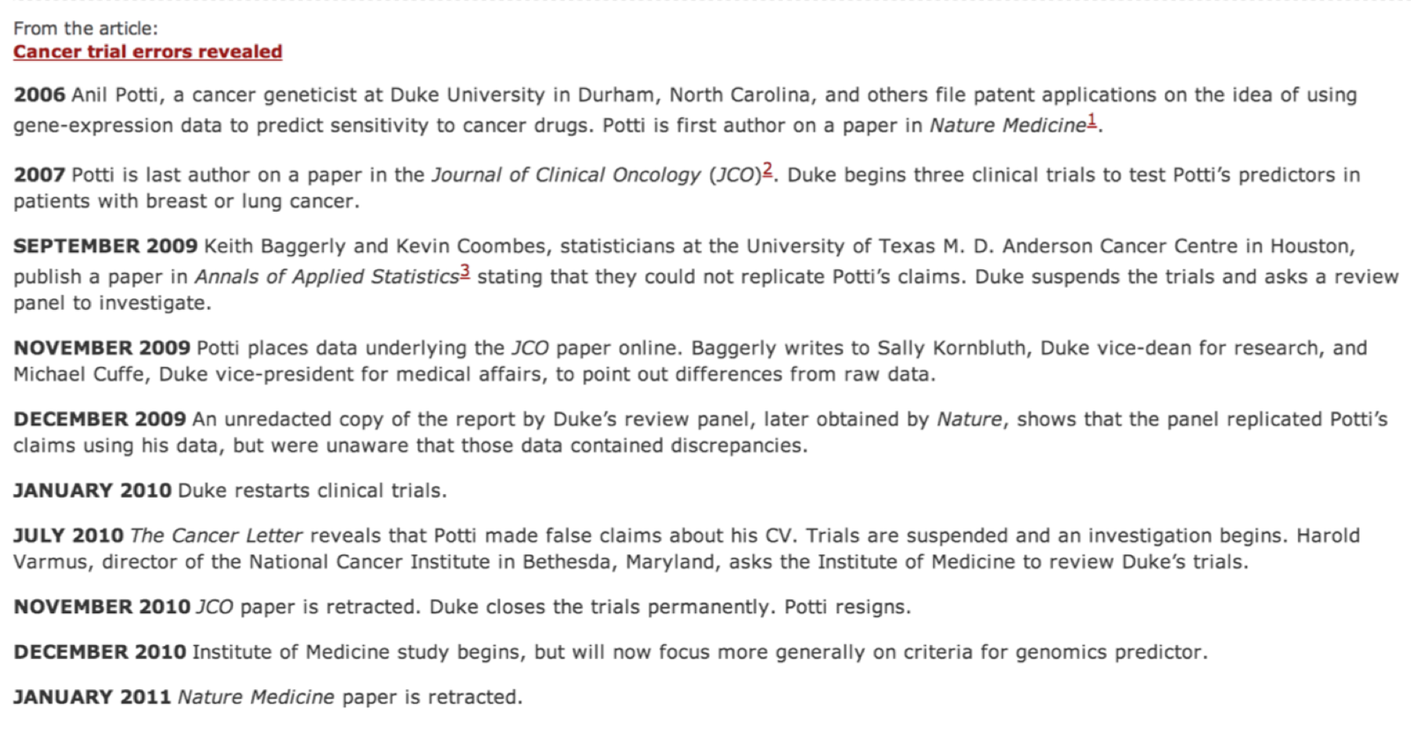
http://www.nature.com/news/2011/110111/full/469139a/box/1.html

Slide 14
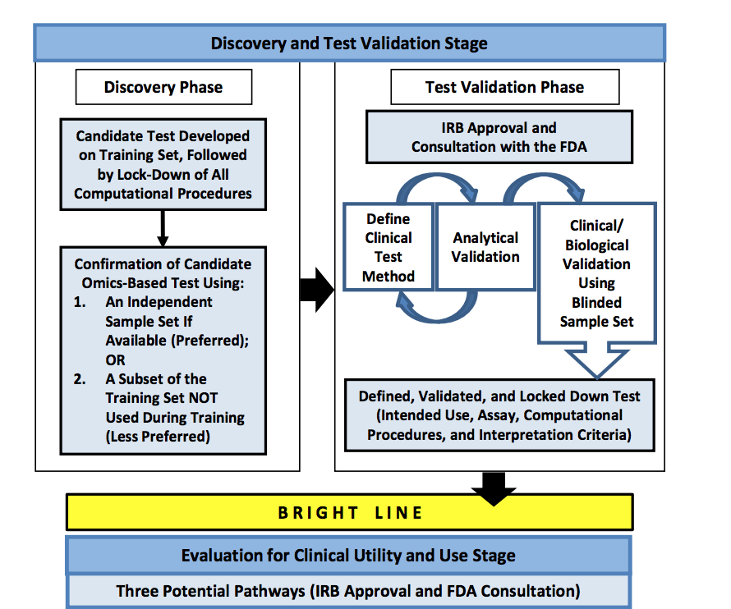
http://www.nationalacademies.org/hmd/Reports/2012/Evolution-of-Translational-Omics.aspx

Slide 15
Code + documentation
Versions of software
Data provenance

Slide 16
Your closest collaborator is you six months ago, but you don’t reply to emails
Karl Broman
(http://kbroman.org/Tools4RR/assets/lectures/06_org_eda.pdf)

Slide 17
RStudio Projects

Slide 18
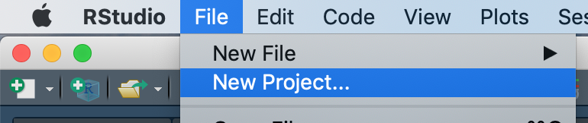
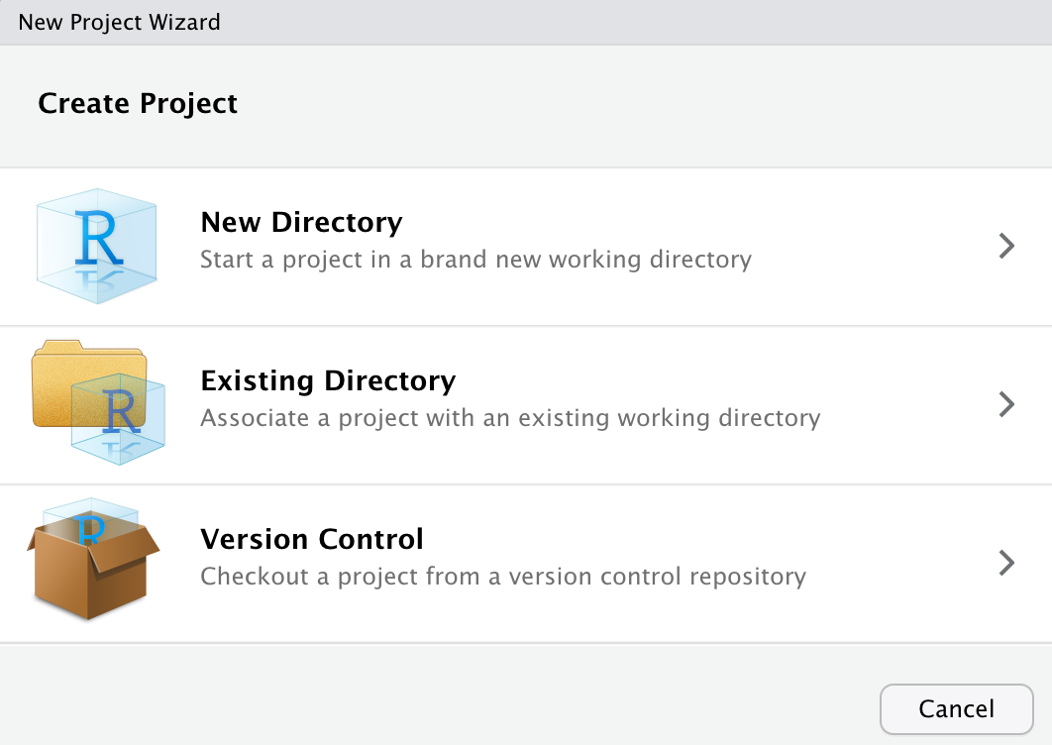

Slide 19
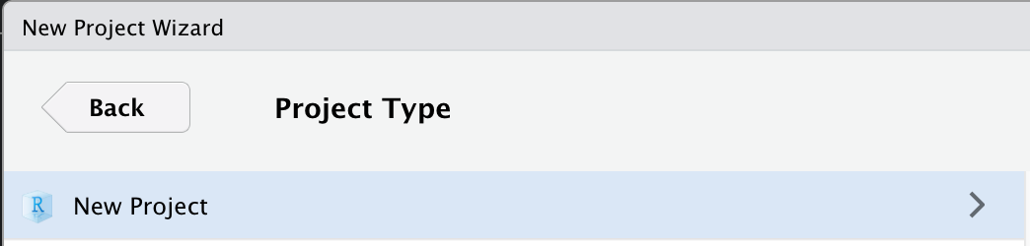
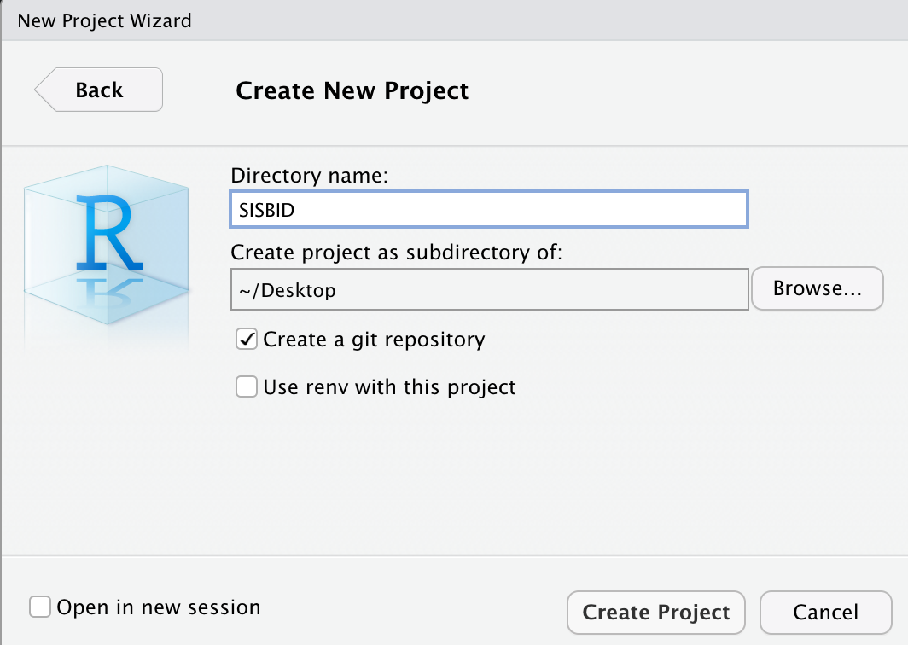

Slide 20
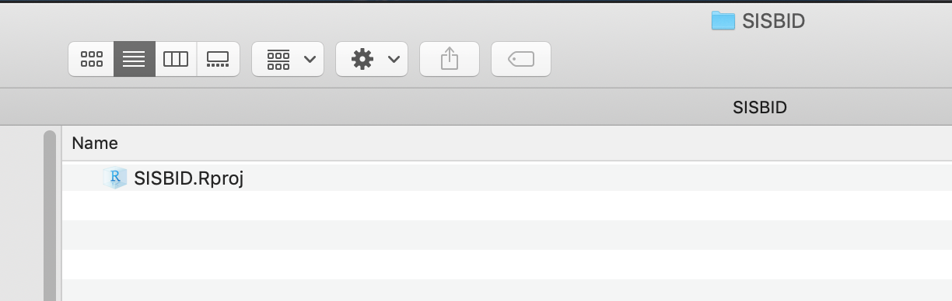
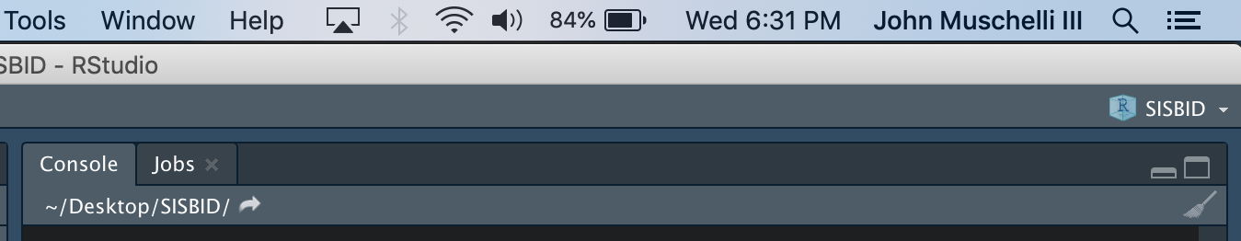
Double click on the Rproj file - opens RStudio

Slide 21


RStudio Projects
Rproj - Open to directory of Project
Everything is *relative* to working directory
Zip up whole folder and send to someone else
read_csv("C:/terrible/path/john/blah.csv")
read_csv("data/blah.csv")

Slide 22
Could you just re-run that code with the [latest/different/best] parameters?
Every collaborator/PI

Slide 23
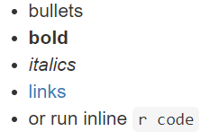
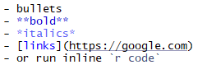
The magic of Markdown
https://rmarkdown.rstudio.com/authoring_basics.html

Slide 24
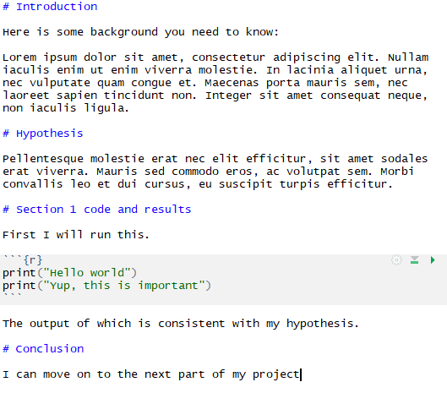
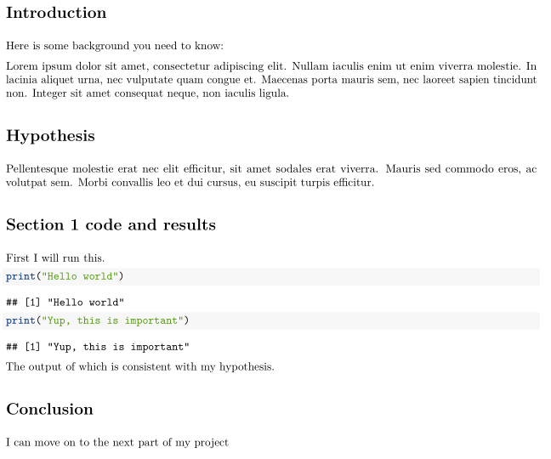
.Rmd document
PDF, HTML or Word document

Slide 25
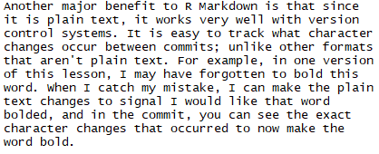
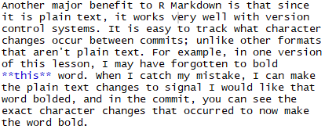
Notes:
Colored

Slide 26
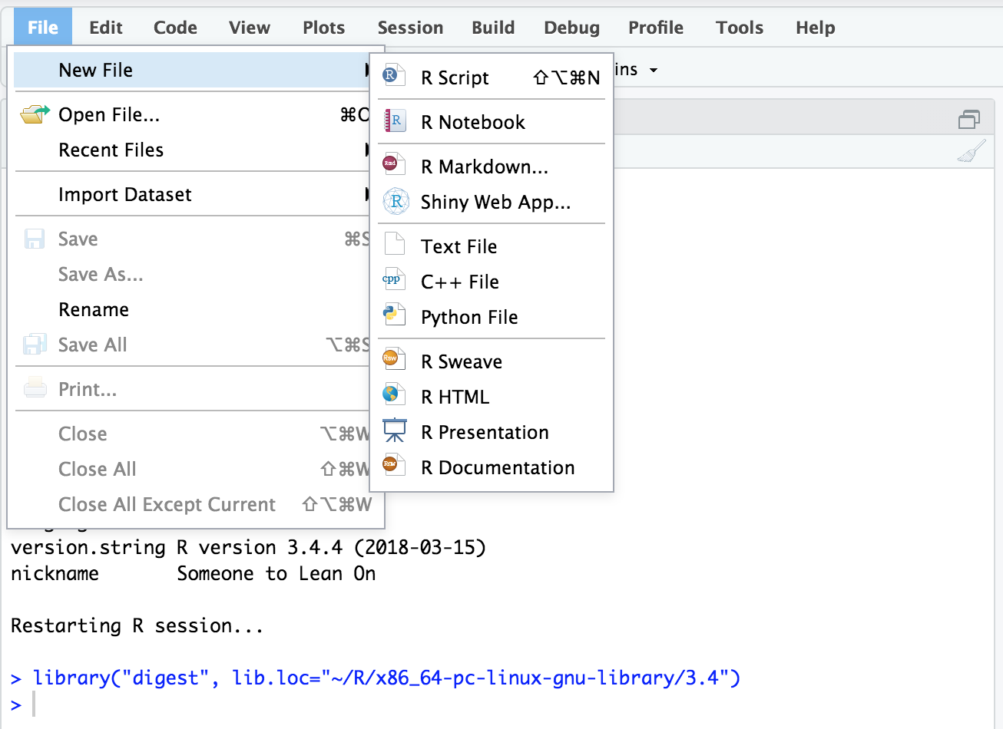


Slide 27
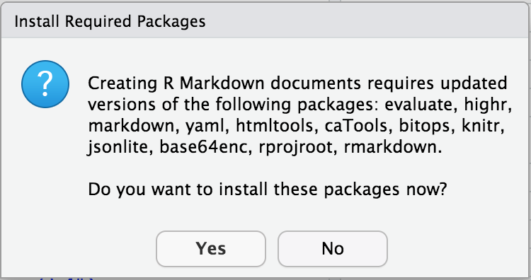

Slide 28
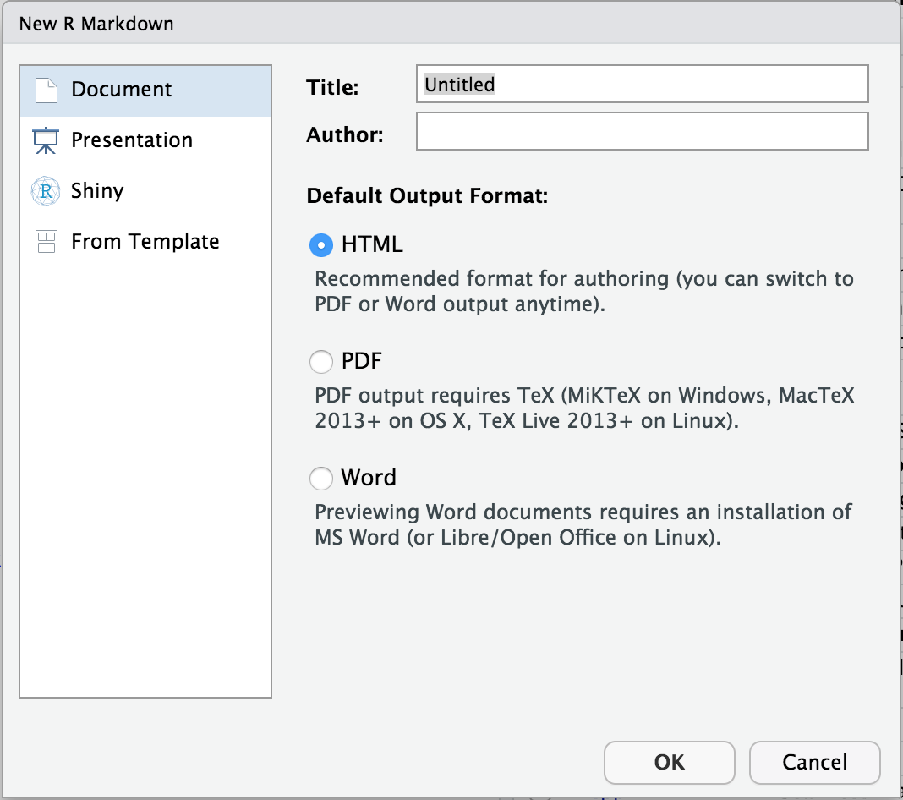

Slide 29
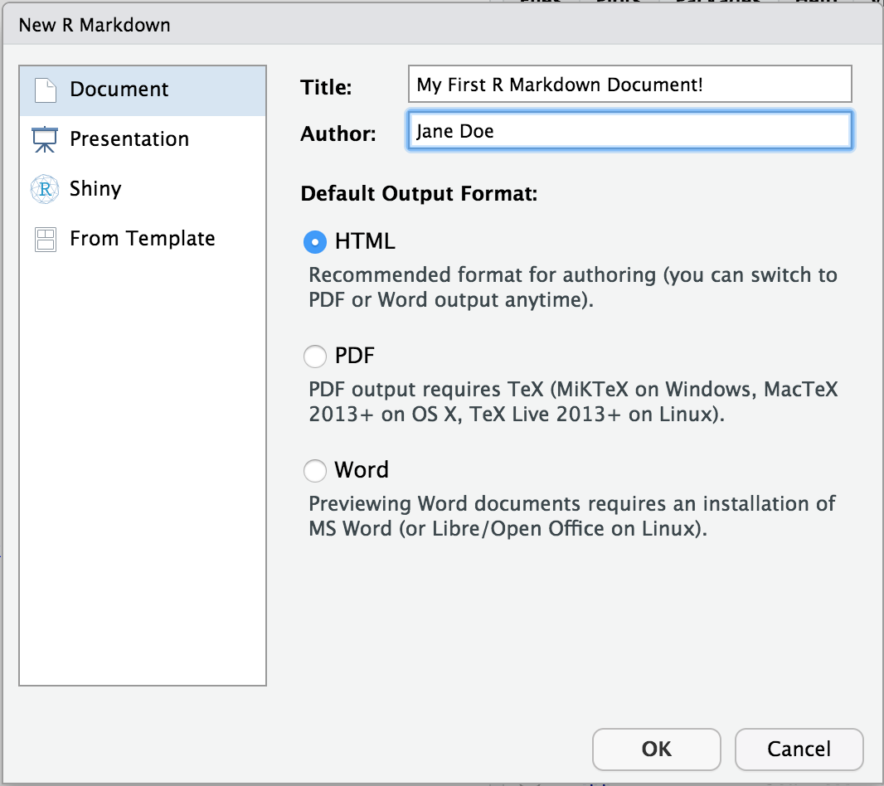

Slide 30
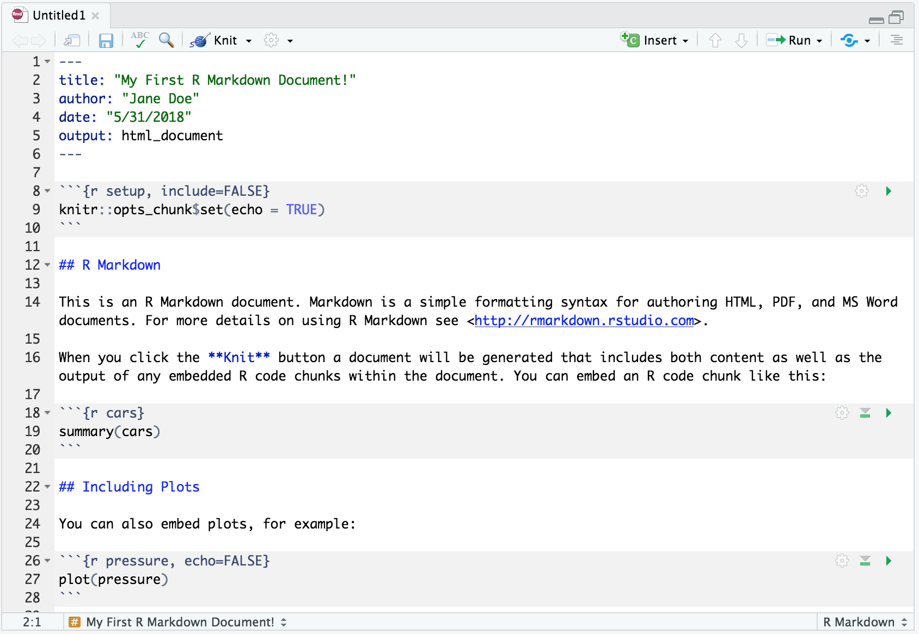
YAML - not markdown,
Spaces matter, usually goes
option: value
TEXT
CODE CHUNK

Slide 32
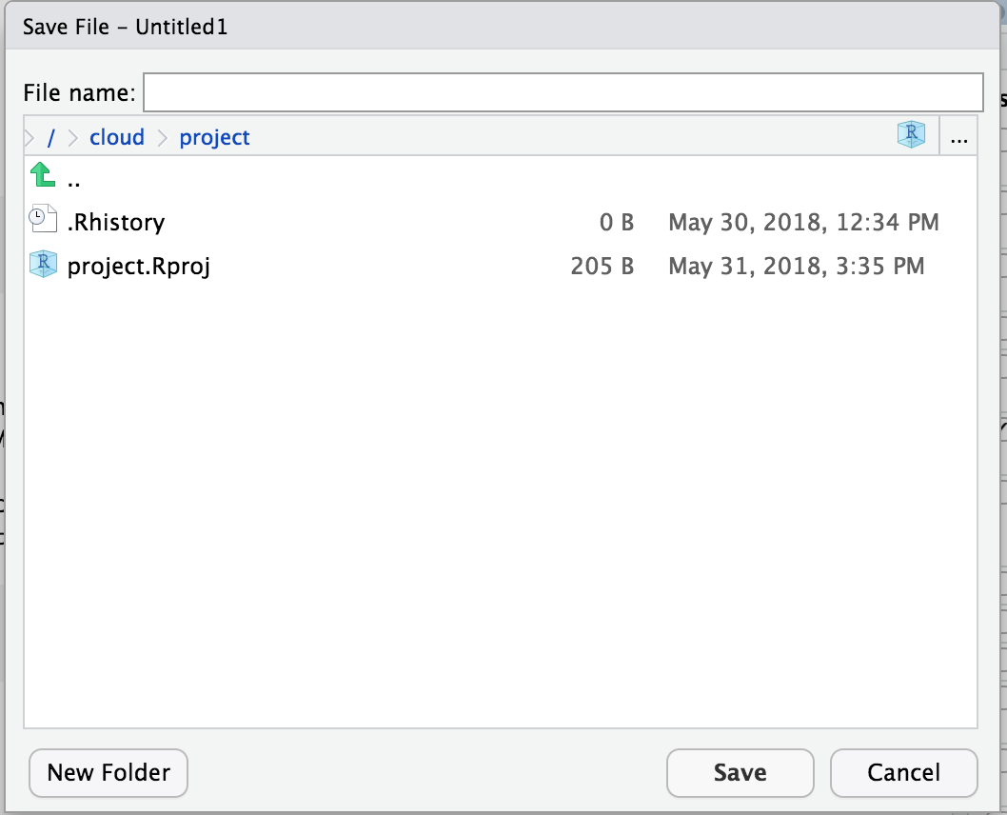

Slide 33
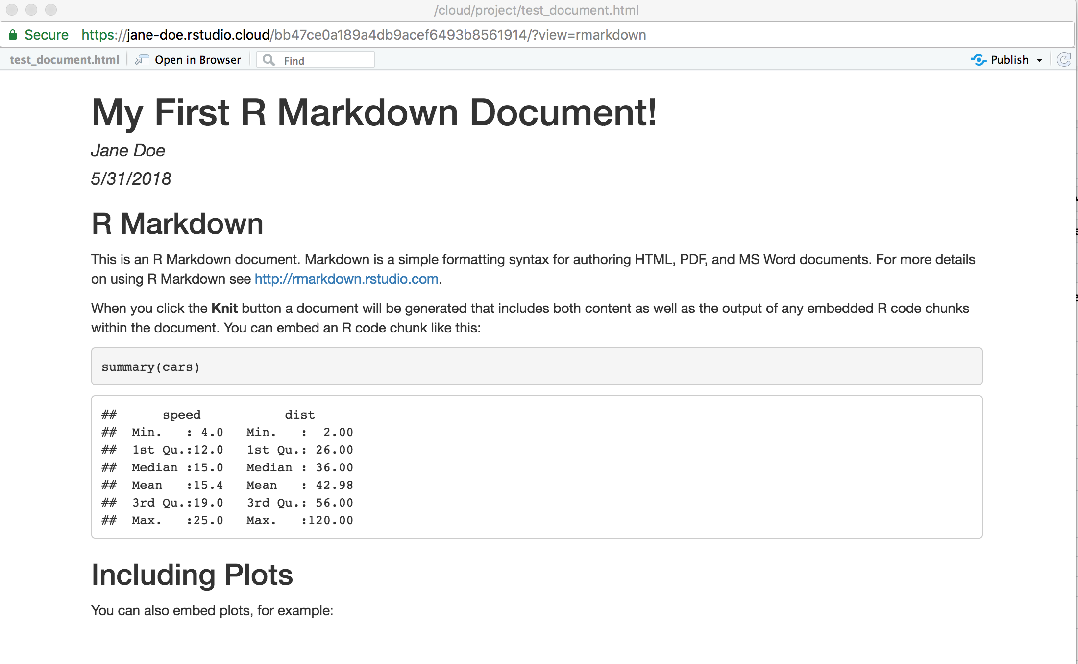
Header rendered as the title
Text section rendered as formatted text
Code rendered as the input code AND the output of running the code chunk

Slide 34
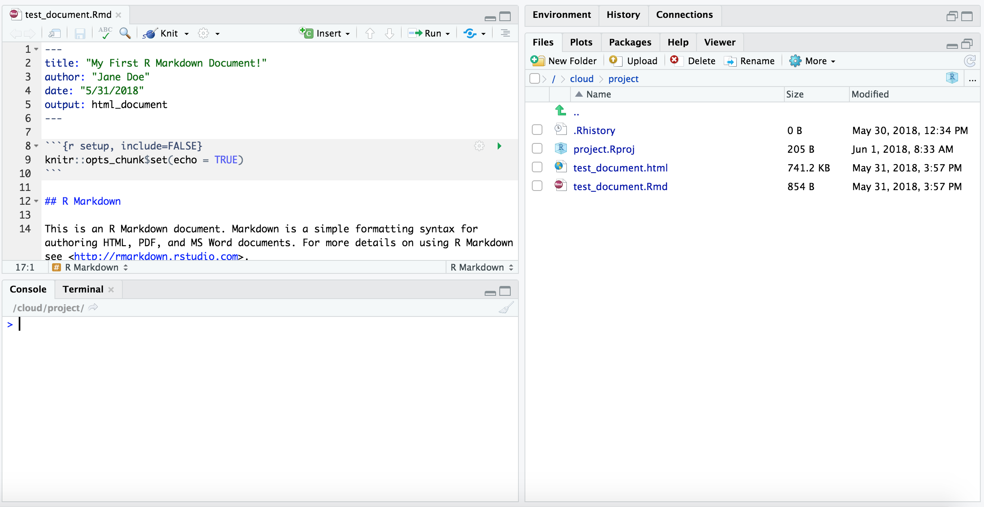

Slide 35
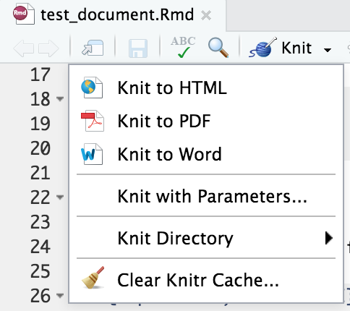

Slide 36
Rendering in R
library(rmarkdown)
render("Untitled.Rmd")

Slide 37
Session information - what's loaded?
devtools::session_info()
# comment-for specific package
devtools::session_info("pkg")

Slide 38
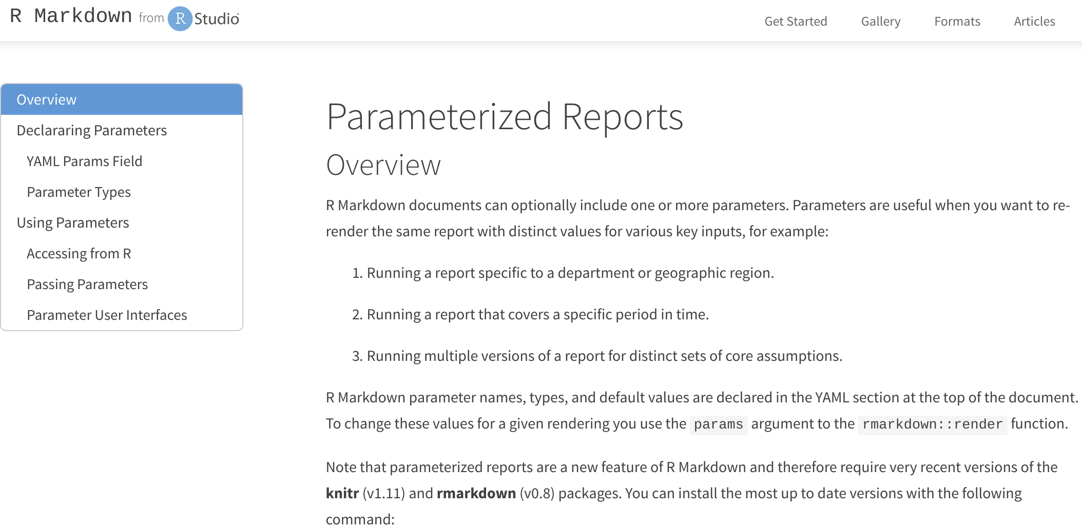
http://rmarkdown.rstudio.com/developer_parameterized_reports.html

Slide 39
Set parameters in yaml
--- title: My Document output: html_document params: region: east ---

Slide 40
Can set any R type if you use !r before expression
--- title: My Document output: html_document params: start: !r as.Date("2020-01-01") ---

Slide 41
Accessing the parameters
params$region
params$start

Slide 42
Barely scratching the surface

Slide 43
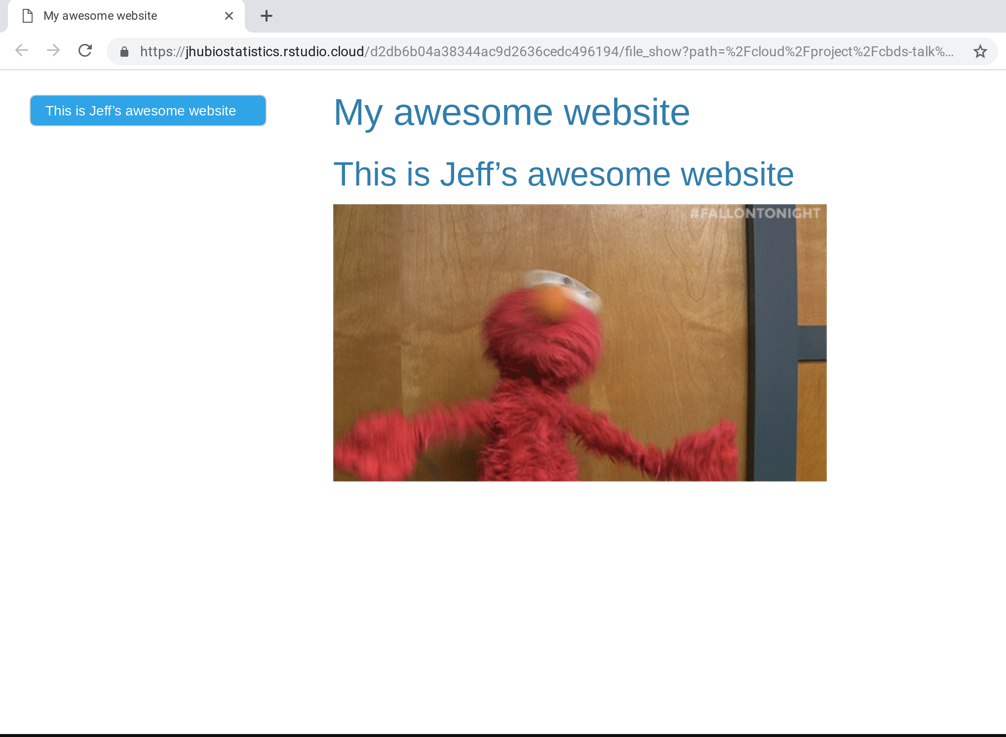

rmarkdown
--- title: "My awesome website" output: html_document: toc: true toc_float: true theme: cerulean --- # This is Jeff's awesome website ![](https://media.giphy.com/media/drXGoW1iudhKw/giphy.gif)

Slide 44
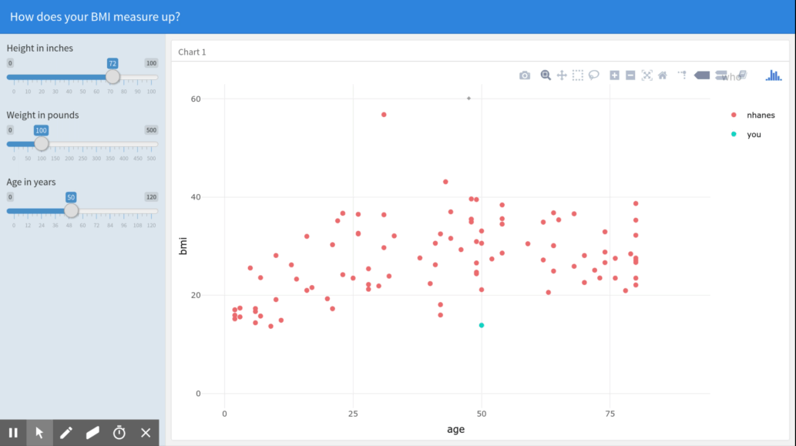
flexdashboard
--- title: "How does your BMI measure up?" output: flexdashboard::flex_dashboard runtime: shiny --- Inputs {.sidebar} ------------------------------------- ```{r} library(flexdashboard); library(NHANES); library(plotly);library(dplyr) sliderInput("height", "Height in inches",0,100,72) sliderInput("weight", "Weight in pounds",0,500,100) sliderInput("age", "Age in years",0,120,50) ``` Column ------------------------------------- ### Chart 1 ```{r} nhanes = sample_n(NHANES,100) renderPlotly({ df = data.frame(bmi = c(nhanes$BMI,input$weight*0.45/(input$height*0.025)^2), age = c(nhanes$Age,input$age), who = c(rep("nhanes",100),"you")) ggplotly(ggplot(df) + geom_point(aes(x=age,y=bmi,color=who)) + scale_x_continuous(limits=c(0,90)) + scale_y_continuous(limits=c(0,60)) + theme_minimal() ) }) ```

Slide 46
Downloading data reproducibly

Slide 47
Finding and creating files
getwd() # get working directory
setwd("data") # set
file.exists("data")
dir.create("data")
list.files("data")

Slide 48
Putting it together
if(!file.exists("data")){ dir.create("data") }

Slide 49
Finding and creating files
file.exists("data")
dir.create("data")
list.files("data")

Slide 50
fileUrl <- "https://data.baltimorecity.gov/api/views/dz54-2aru/rows.csv?accessType=DOWNLOAD"
curl::curl_download(fileUrl, destfile="./data/cameras.csv") list.files("./data") dateDownloaded <- date() dateDownloaded

Slide 51
Rmarkdown lab
https://bit.ly/1LRk3ds
Download the file from https://github.com/SISBID/Module1/raw/gh-pages/labs/rmarkdown-lab.Rmd

